Slide 1
Mount Harvard
MSBX 5420 Unstructure Dist Data Mod/Analys
Jenna Beulter, Seth Grossman, Hua Miao, Samuel Statton, Nhi Vo
Notes:
hua

Slide 2
Agenda
Project Intro
Data Summary
Coding Process
Result Summary
Conclusion
Notes:
Hua

Slide 3
Dataset Introduction
Link: https://www.kaggle.com/smid80/coronavirus-covid19-tweets#2020-03-00%20Coronavirus%20Tweets%20(pre%202020-03-12).CSV
The original dataset has 22 columns. We dropped 13 columns in order to simplify our data and take the columns what we need for our analysis.
Date, favourites_count, followers_count, retweet_count, screen_name, source, text, verified, lang
Notes:
Hua
verified: Whether the account that Tweeted is verified.
lang: The language of the Tweet.

Slide 4
Main Goal
What aspects of a tweet drives higher number of likes a tweet receives in tweets related to the Coronavirus pandemic.
Performing predictive analysis on a dataset of over 8 million tweets in english, between March 4 and March 28.
Notes:
Jenna

Slide 5
CONTINUED...
Our team using Machine Learning techniques combined with Spark, AWS, and HDFS to parse the dataset above and find common topics/sentiment that appeared on Twitter with the hashtags:
#coronavirus
#coronavirusoutbreak
#coronavirusPandemic
#covid19
#covid_19
Notes:
Jenna

Slide 6
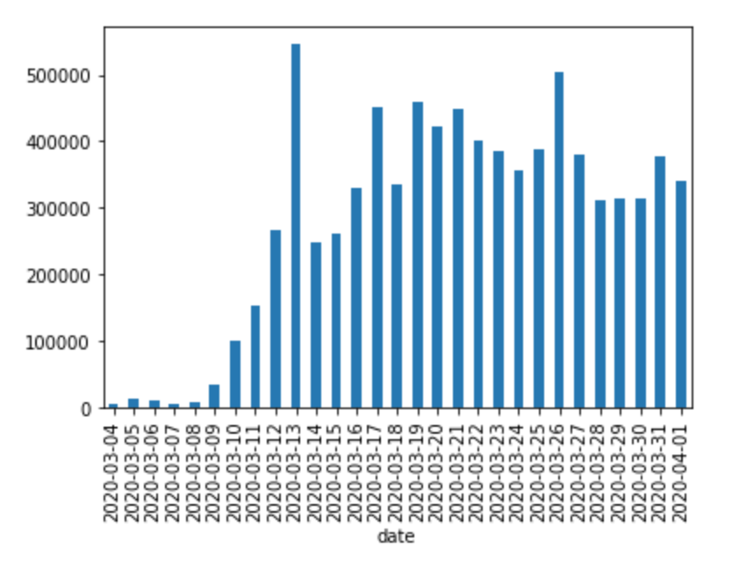
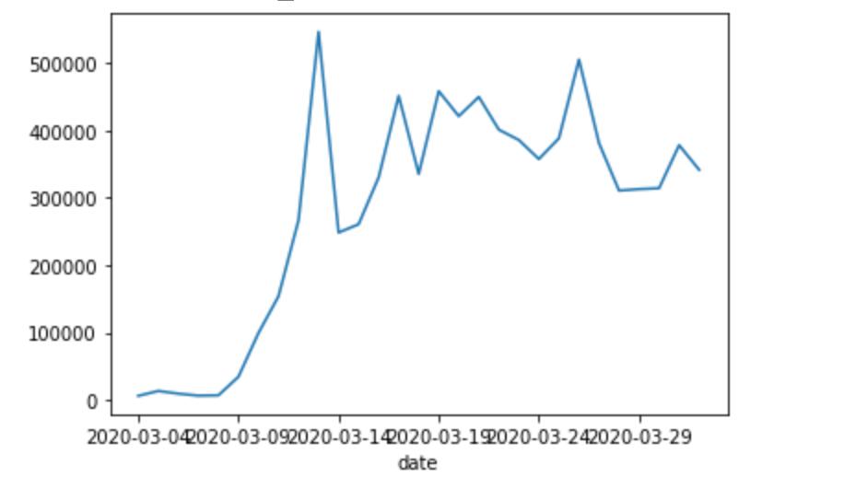
A Quick Glimpse at the Data
Number of Tweets Per Day
Notes:
Nhi

Slide 7
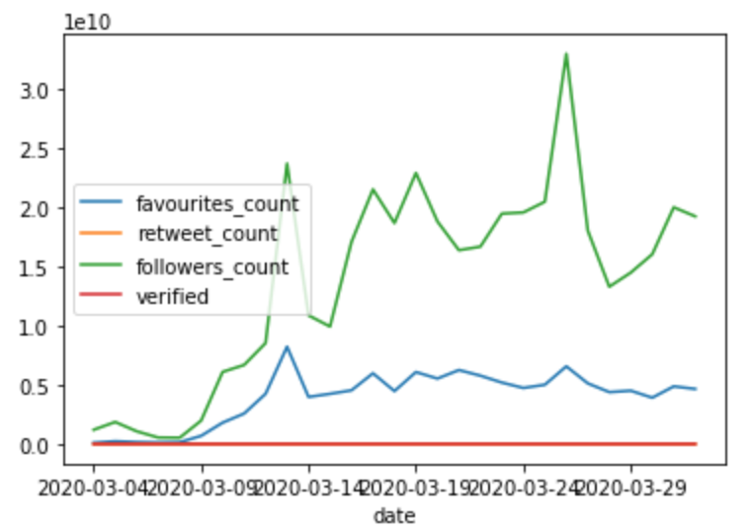
Sum of the Numeric Variables
Breakdown of the sums of all the numeric variables
Notes:
Nhi

Slide 8
Architecture
myBinder
Github
Pyspark
AWS
Notes:
Seth

Slide 9
Process
Set up a myBinder which preserved our environment while we worked on it.
Built the code on a small portion of the tweets, selected randomly
Notes:
Seth

Slide 10
Training the Data
Started with train and test sets, split the data
Our R-squared values were very low
When we ran on the test set, the R-squared value outside the range of -1 to 1
We ran a train model on the a entire data set and ran the model that we got back, on the full data set.
Notes:
Sam

Slide 11
Machine Learning
Using Linear Regression to predict number of favorite Tweets received. based on retweets, followers, verified status, and text features.
Text features looks at the text and does an inverse document frequency to measure special words that are weighted
Pyspark regression needs all predictor columns as a single vector
Training model has a 0.71 r-squared value.
Notes:
sam

Slide 12
Conclusion
Tweets created by humans is very difficult to predict because of human behavior.
Though, our data set had a R-squared value of .71, we had to run it on the entire data set to get a fitted value on our small data set. (roughly 81,000 data points)
When we deployed it on our full data set in the dev cluster (8 million data points) we got an R-squared value of .09, which means the number of favourited tweets is difficult to predict.
Notes:
sam

Slide 13
Thank you for listening!
Any Questions?

